Slide 1
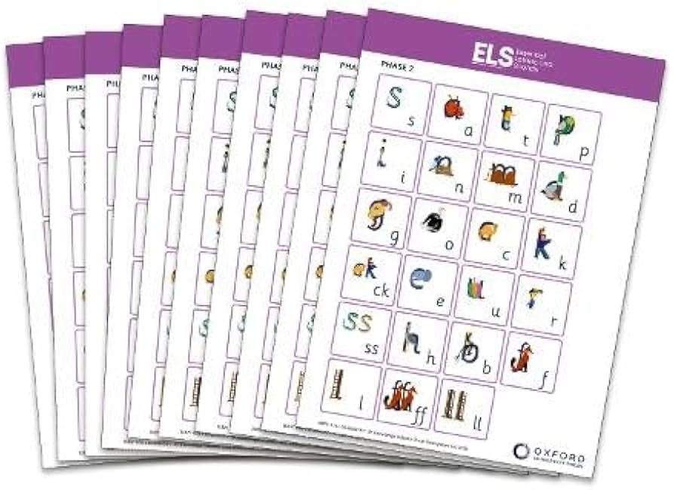
Phonics and Reading
An essential method for teaching reading and writing
Notes:
Hello everyone, welcome to the Year R phonics workshop.

Slide 2
What is phonics?
Phonics is a way of teaching children to read and write
We teach them that sounds are represented by letters, and that letters represent sounds
We teach the children how to blend sounds together to be able to read words
We teach the children how to segment a word to be able to spell it and write down the corresponding sounds
At Pinewood we follow a scheme called ELS (Essential Letters and Sounds) – new to us this year

Slide 3
Phonics Glossary
Phonemes - The smallest unit of sound e.g. sh, ai, t, p, m etc.
Graphemes - A written symbol that represents a sound (phoneme). This can be a single letter, or a sequence of letters (e.g. ai, sh). When a child says the sound /t/ this is a phoneme, but when they write the letter 't' this is a grapheme.
GPC = Grapheme Phoneme Correspondence – knowing which sounds go with which letters
Blending – Recognising individual sounds, merging them together e.g. t-i-n. This is the basis of reading.
Segmenting - Chopping up a word and saying the individual sounds in order and putting it back together e.g. t-i-n, f-r-o-g, sh-i-p. This is the basis for writing
Digraph - A combination of two letters representing one sound, as in sh, ck, ee.
Trigraph – A combination of three letters representing one sound e.g. igh.

Slide 4
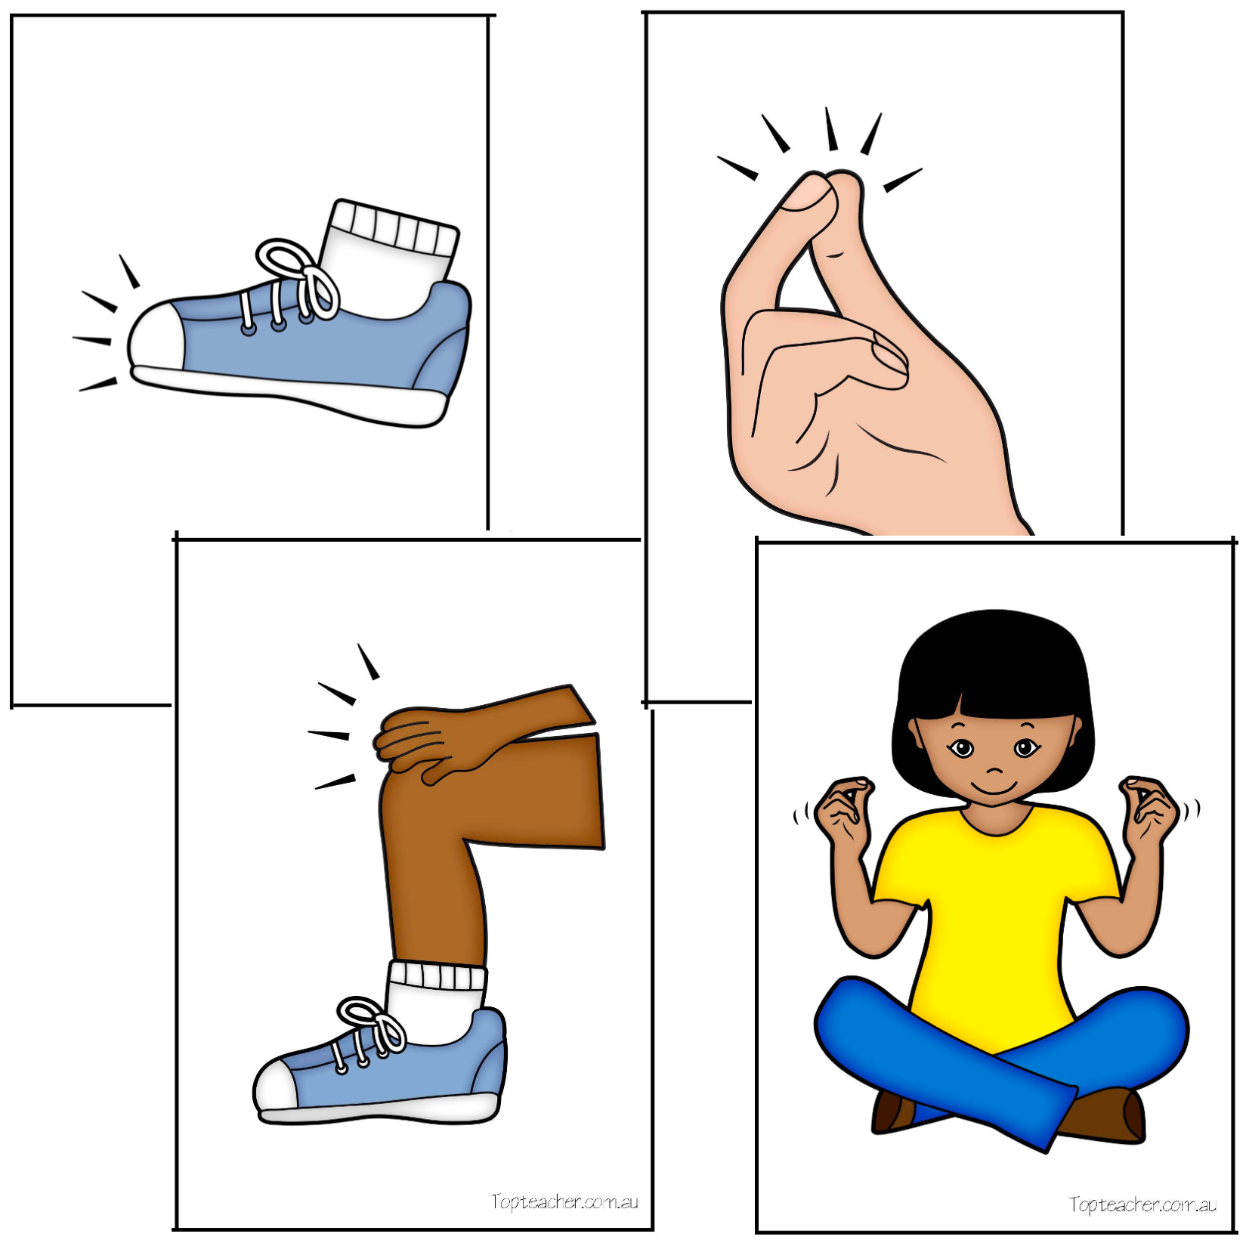



Phase 1
There are 7 aspects…
Environmental sounds
Instrumental sounds
Body percussion sounds
Rhythm and Rhyme
Alliteration
Voice sounds
Oral Blending and segmenting

Slide 5
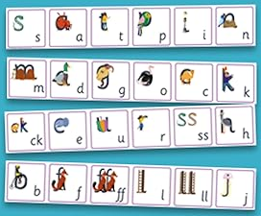
Phase 2
Phase 2
We teach the children…
How to say the sound
What the sound looks like
A ‘cued articulation’ action to go with the sound to help them remember how to say it
A short rhyme to help remember what it looks like
How to write it
How to read words and sentences using these sounds
How to write words using these sounds

Slide 6
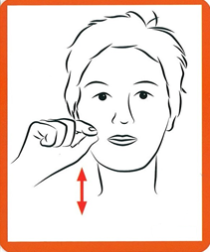
Cued Articulation
As we teach the sounds we also teach an action that goes alongside the sound. This is called cued articulation. The actions have been designed to remind the children how to make the sound and where the sound comes from.
A video is on the school website
if you ever want to be reminded of the actions

Slide 7
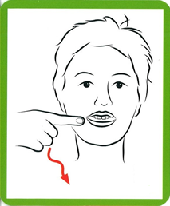

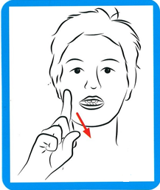
s a t

Slide 8

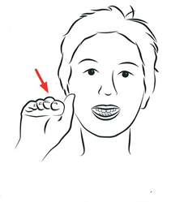
p i n

Slide 9
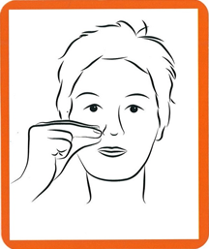
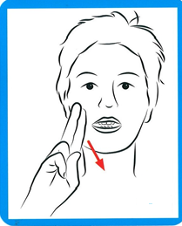
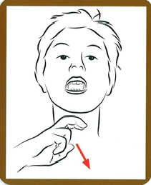
m d g

Slide 10
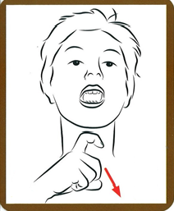
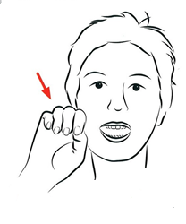
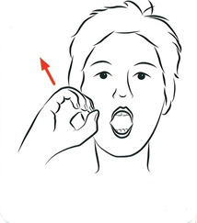
o c/k/ck e

Slide 11
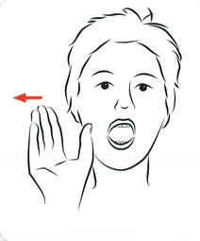
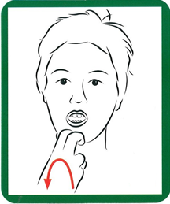

u r h

Slide 12
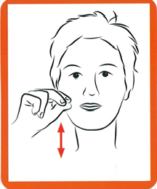
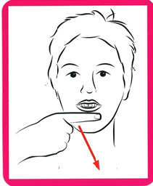
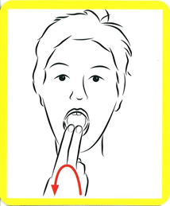
b f l

Slide 13
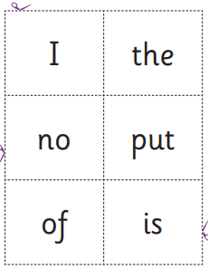
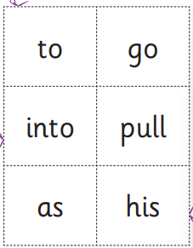
We also teach Hard to Read and Spell Words (HRSW)
(used to be called tricky words)
These are words you can’t sound out

Slide 14
Then we can begin to read simple sentences!
I can hop.
The sock is red.
Can I go on the bus?

Slide 15

ELS Support at home
On the Oxford Owl Website
https://home.oxfordowl.co.uk/reading/reading-schemes-oxford-levels/essential-letters-and-sounds/
Search ‘ELS’ on the website
You can access videos to help with sound pronunciation, flash cards and rhymes, and videos on how to support your child to read at home

Slide 16
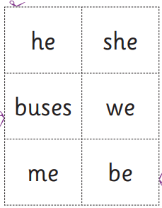
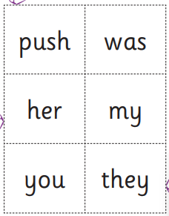
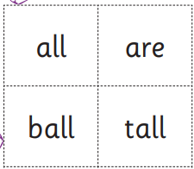
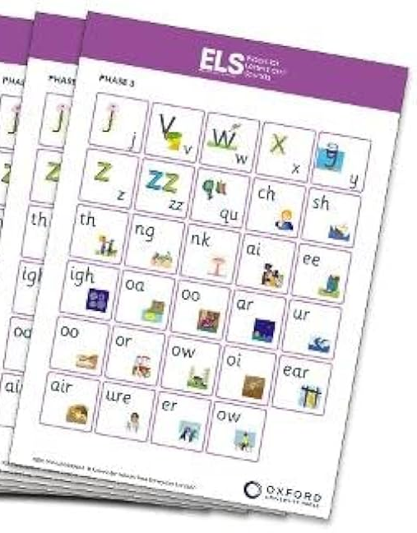
Phase 2
Phase 3
He went to the swimming pool
She has long brown hair
We can look at lots of books!

Slide 17
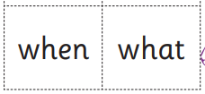
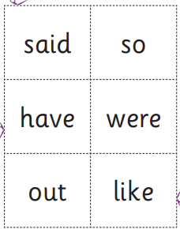
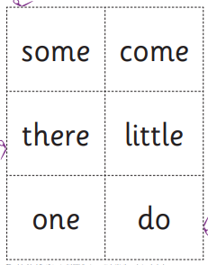
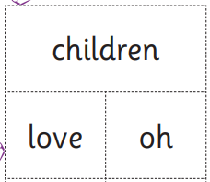
Phase 2
Phase 4
Lots of revision
No new sounds
Learn to read longer words
Learn to read words with different endings

Slide 18
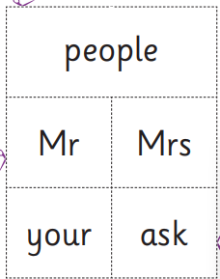
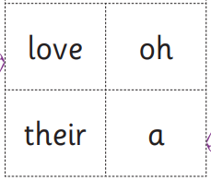
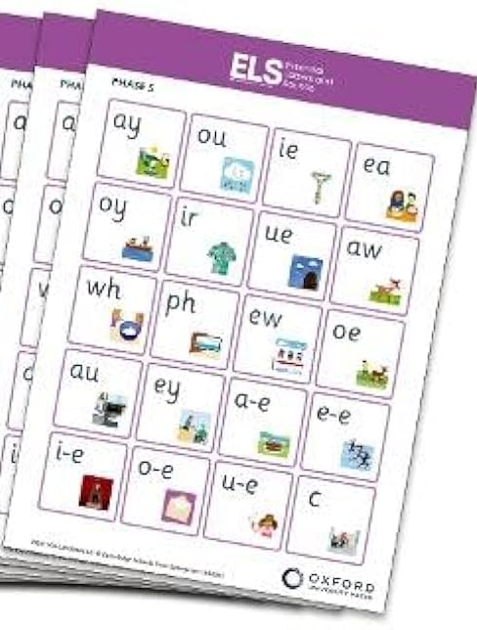
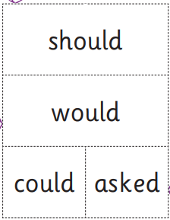
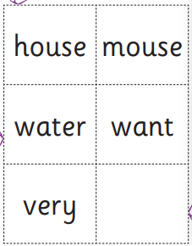
Phase 2
Phase 5

Slide 19
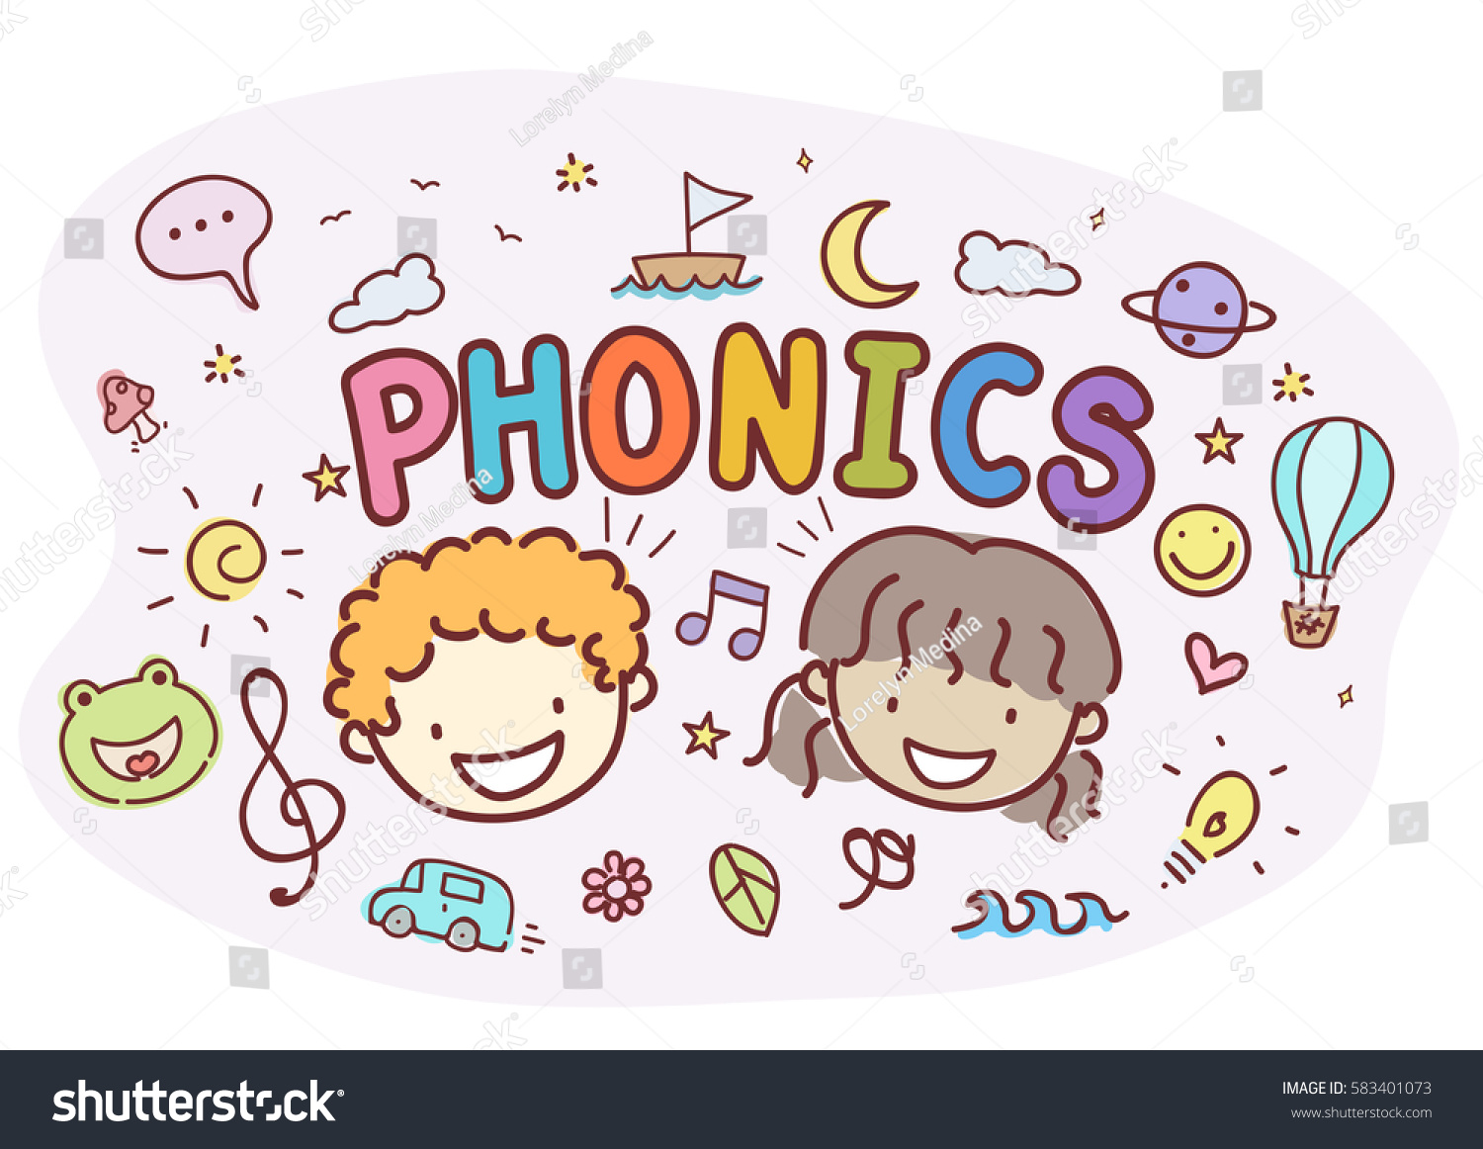
How to support your child at home
We will let you know what sounds we learn each day/week on our walk and talk board. You can help your child remember the sound and think of things beginning with that sound.
Your child will receive weekly phonics activities to practise the sounds and HRS words we learn. It will be given out on a Thursday.
You can practise oral blending. Say sounds to your
child, can they blend the sounds together and say
the word?
Write a simple word using sounds we’ve been
learning, can they add sound buttons and read it?
Notes:
These phonic sheets are not compulsory to complete, so please complete what is right for your child. We do recommend that you practise reading and saying the sounds every time you read.

Slide 20



Reading
Share lots of books at home - talk about rhyme and alliteration, develop vocabulary and story telling, use the pictures to help build understanding
Ask them to spot different sounds or HRS words you know that they have been learning. Use the pictures to play eye spy “Can you find something beginning with c? Can you find something beginning with s?”
Practise the school reading books - We will read and change books in school on Thursday
Remember to keep reading fun and not too long
Repetition is important to build confidence and fluency - but shake things up and make it different each time
Notes:
Phonic books are sent home to link with the phonics being taught in school. For example, this week we are doing s,a,t, and next week p, I,n. They are books where most of the words are decodable and contain the focus sounds. At this early stage, your child may not have gained the confidence in order to fully decode and read the words. Don’t panic! Try playing I spy with the pictures, finding things beginning with s etc. Or can the spot s, a t within the words.
Your child will now have 2 books in total. You only need to read 1 book each night. Please record what they read from either book.

Slide 21
Other useful websites
https://www.bbc.co.uk/cbeebies/shows/alphablocks
https://www.oxfordowl.co.uk/for-school/oxford-owl-ebook-collection
https://www.teachyourmonstertoread.com/?gclid=EAIaIQobChMI6a6g4fnR3gIVSbDtCh0CuAZCEAAYASAAEgLYH_D_BwE ☺ free (app is not)
https://www.youtube.com/watch?v=BqhXUW_v-1s Video of the sounds.
www.Phonicsplay.co.uk A few free games on here.
https://www.theschoolrun.com/

