Slide 1
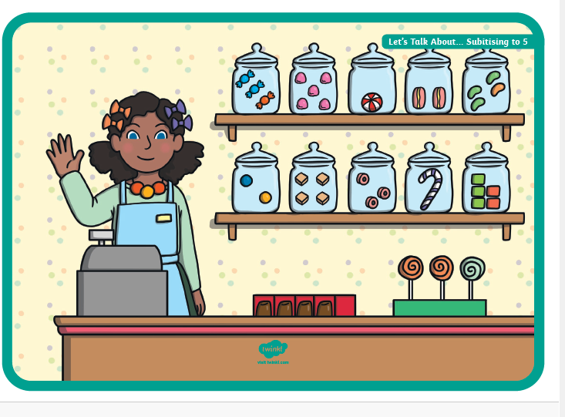

YEAR R MATHS WORKSHOP 2026
What do you notice?

Slide 2
WHAT MATHS IS COVERED IN YEAR R?
Count objects, actions and sounds.
• Subitise.
• Link the number symbol (numeral) with its cardinal number value.
• Count beyond ten.
• Compare numbers.
• Understand the ‘one more than/one less than’ relationship between consecutive numbers.
• Explore the composition of numbers to 10.
• Automatically recall number bonds for numbers 0–5 and some to 10.
• Select, rotate and manipulate shapes in order to develop spatial reasoning skills.
• Compose and decompose shapes so that children recognise a shape can have other shapes within it, just as numbers can.
• Continue, copy and create repeating patterns.
• Compare length, weight and capacity.

Slide 3
EARLY LEARNING GOALS (END OF YEAR R)
Number
• Have a deep understanding of number to 10, including the composition of each number.
• Subitise (recognise quantities without counting) up to 5.
• Automatically recall (without reference to rhymes, counting or other aids) number bonds up to 5 (including subtraction facts) and some number bonds to 10, including double facts.
Numerical Patterns
• Verbally count beyond 20, recognising the pattern of the counting system.
• Compare quantities up to 10 in different contexts, recognising when one quantity is greater than, less than or the same as the other quantity.
• Explore and represent patterns within numbers up to 10, including evens and odds, double facts and how quantities can be distributed equally

Slide 4
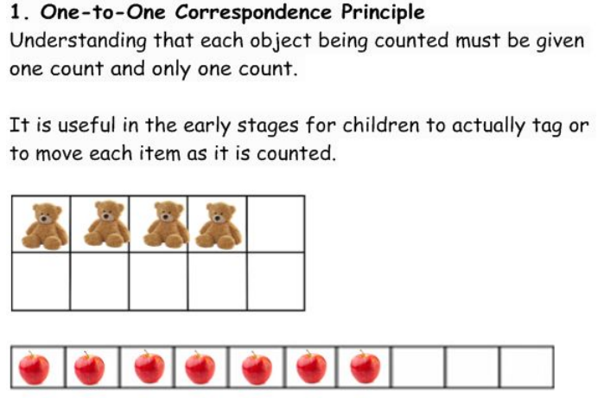
COUNTING PRINCIPLES
Notes:
We can often rush towards the symbols when learning Maths, counting is the same. We need to learn how to count before we introduce the symbols.
Have counters, tens frames and number tracks on the tables. Demonstrate ways of counting. How many bears do I have? Tap 1,2,3,4 bears, I have 4 bears. Now give me 4 bears from a larger group. Help parents to see the difference.

Slide 5
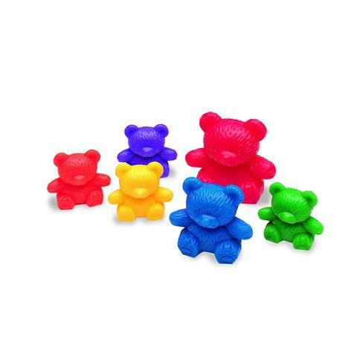
COUNTING PRINCIPLES
Cardinality of Number.
Understanding that the last count of a group of objects represents how many are in the group.
There are 1,2,3,4,5,6 bears, there are 6 bears.

Slide 6
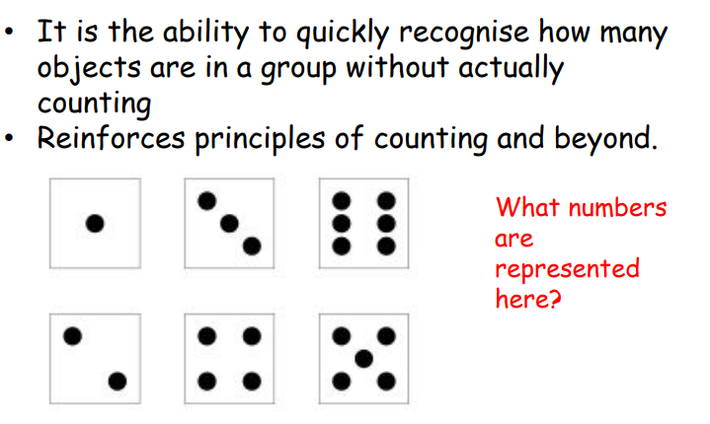
SUBITISING

Slide 7
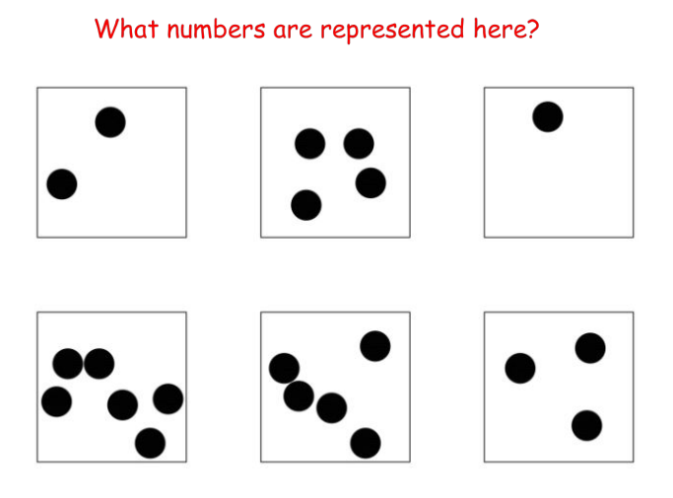
.
.
Notes:
We show lots of different representations of number, to develop subitising skills not just familiar patterns such as those on a dice. They only need to be able to subitise to 5 by the end of YR.

Slide 8
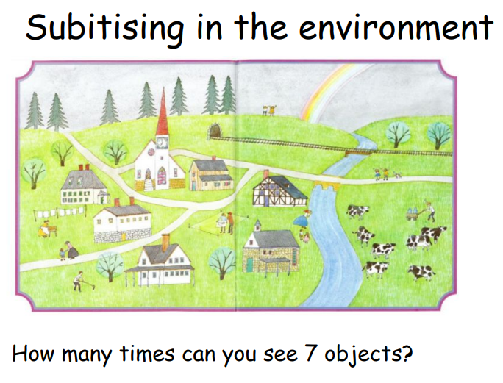
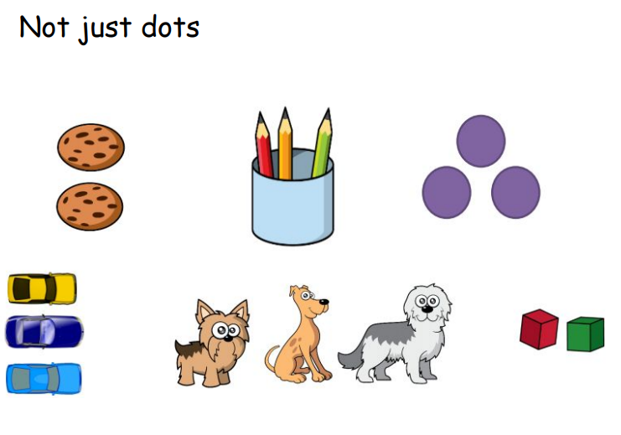
SUBITISING

Slide 9
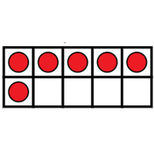


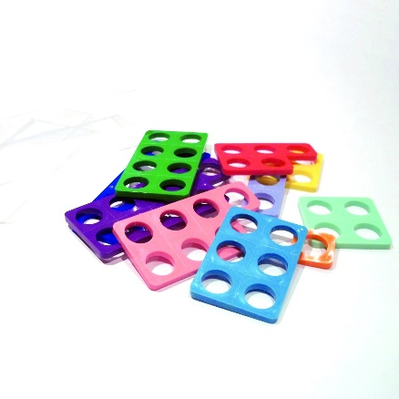
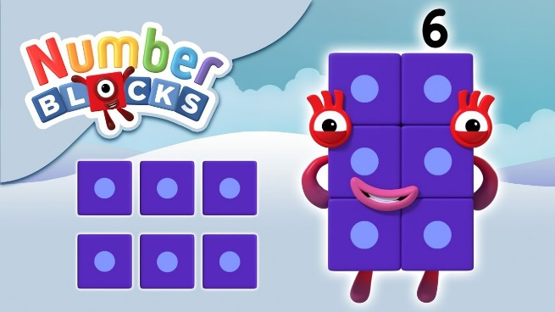
COMPOSITION OF NUMBER
How many ways can you show 6?
Notes:
Using the resources on the table, explore the different ways to show me 6. (Have Numicon, tens frames, bears, number tracks, w/boards and pens, multilink)

Slide 10
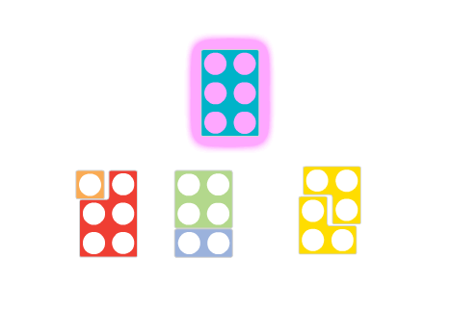
COMPOSITION OF NUMBER
Notes:
Share answers. There any many ways to make 6. We want to encourage the children to keep looking for different representations of number, so that they can see how a number can be made. 2 parts to make 1 whole. This will support them in their future maths learning. For example mental recall for addition and subtraction and identifying number bonds.

Slide 11
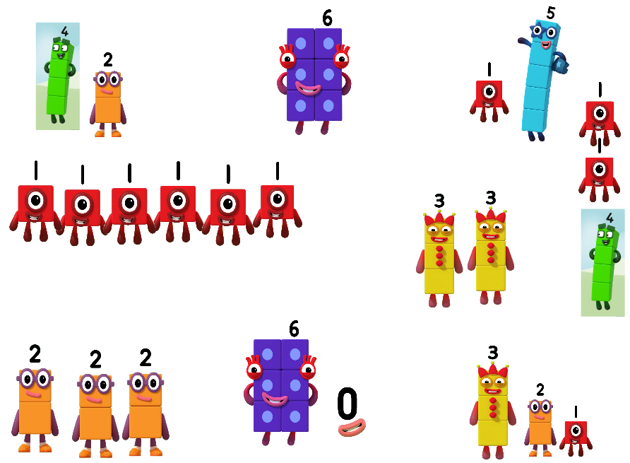
MORE WAYS TO MAKE 6!

Slide 12
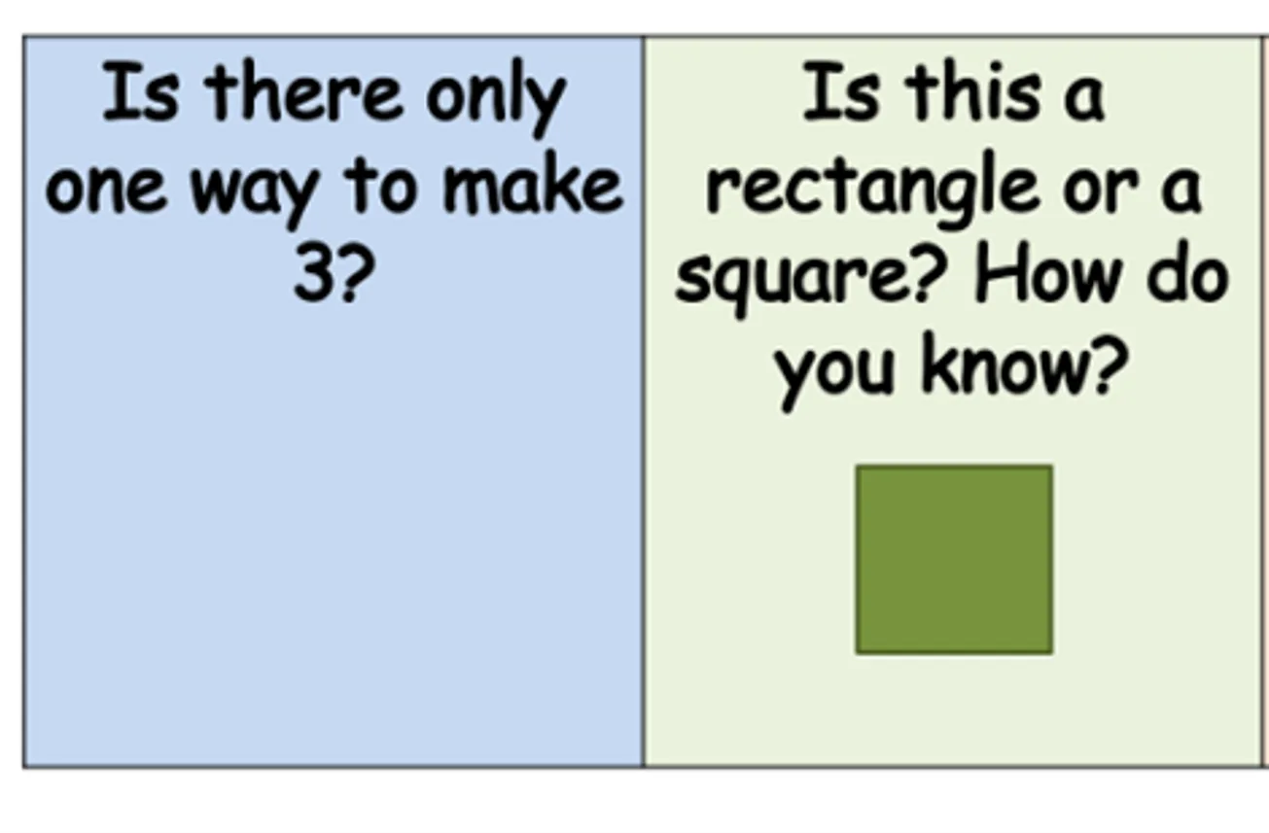
Oracy
The ability to convey thoughts and ideas fluently through speech. In maths, this means children explaining their thinking and reasoning. Using stem sentences will support this.
We will give the children opportunities to discuss their maths to improve their oracy skills…

Slide 13
Stem sentences
Using a structured sentence to use the correct vocabulary and to explain what has happened during the sum.
“First I had 6, then I added 2. Now I have 8.”
“First I had 3, I doubled it. Now I have 6.”

Slide 14
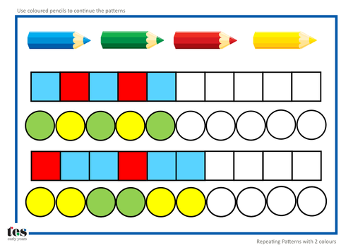
CONTINUE, COPY AND CREATE REPEATING PATTERNS.
Notes:
We start with colours, sounds, objects. This helps to build the foundation for number patterns.

Slide 15
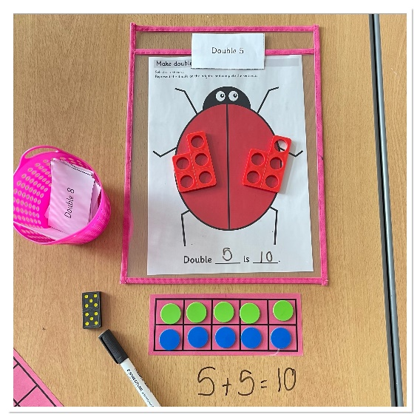
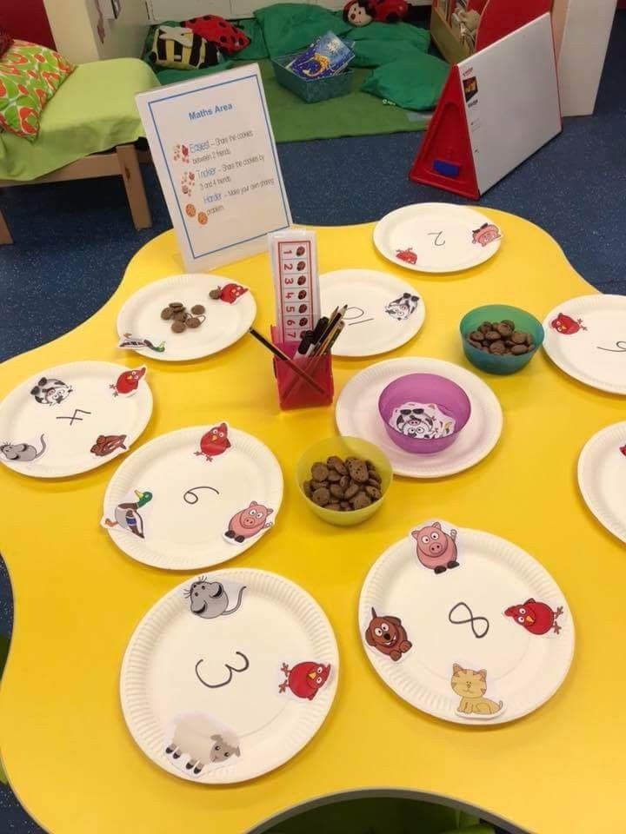

PATTERNS WITH NUMBERS
Odd and Even numbers
Doubling
Sharing numbers equally

Slide 16
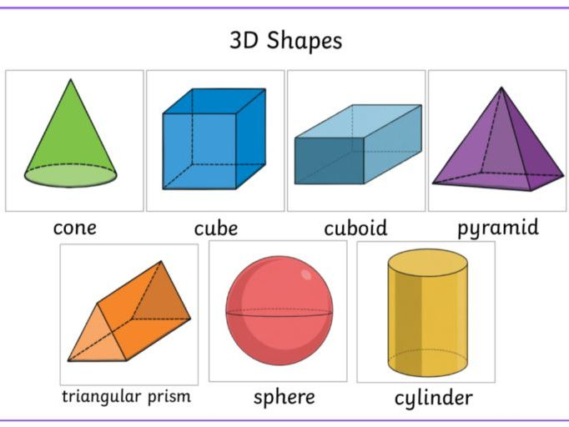
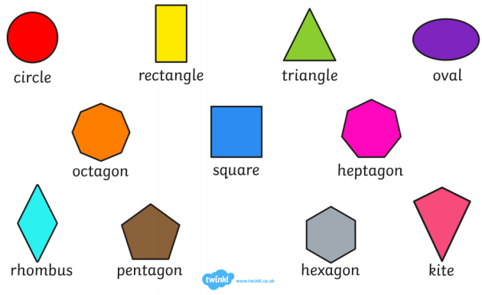
SHAPES
Notes:
We teach the children to recognise and name simple 2D shapes. We look for them in their immediate environment and use them to make patterns and pictures etc. With 3D shapes, we make comparisons with features, whether they roll, have points or edges etc? Compare to real life shapes.

Slide 17
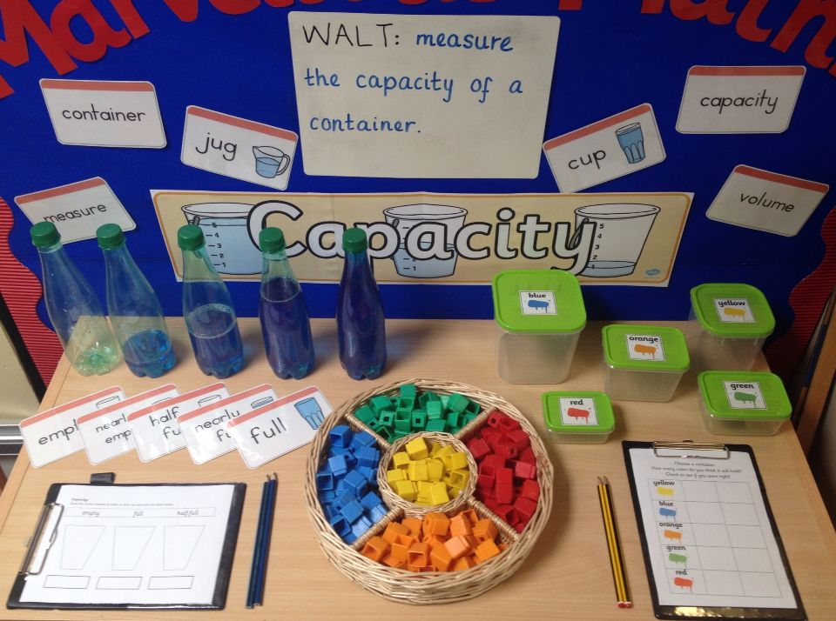
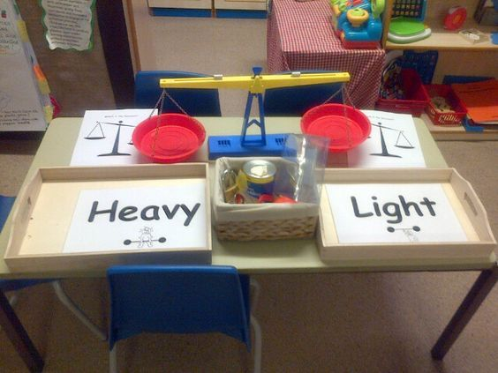
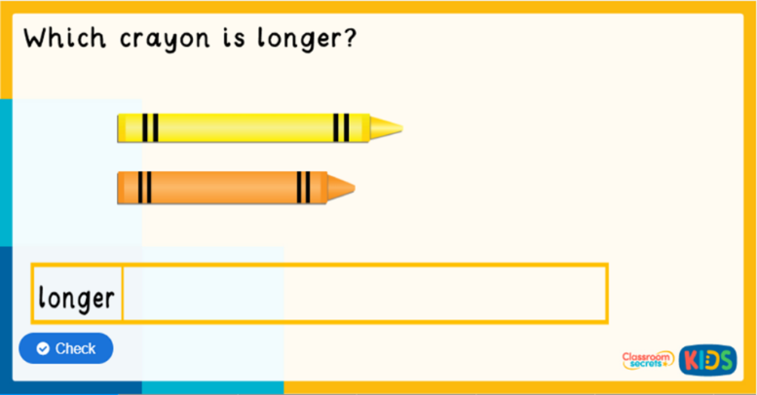
LENGTH, MASS AND CAPACITY
Compare length, weight and capacity.
Notes:
Lots of practical activities, developing language of measure.

Slide 18
HOW CAN YOU HELP YOUR CHILD AT HOME?
Cooking – weighing, capacity, time,
Shopping – money, addition, change / subtraction,
Travel – times, waiting etc.
Clocks – telling the time, daily timetable, what’s happening now, next. What did we do yesterday? What are we doing tomorrow?
Look for numbers in the environment – car journeys, way to school etc. In books, electrical devices.
Playing games together, subitise the number on the dice, count on the spaces etc. Play dominoes, card games etc
Counting ball bounces, catches, kicks, skips etc. Play hopscotch

Slide 19
HOW CAN YOU HELP YOUR CHILD AT HOME?
Encourage estimation, e.g. estimate how many sandwiches to make for the picnic.
Encourage use of mathematical language, e.g. number names to ten: ‘Have you got enough to give me three?’
Use rhymes, songs and stories involving counting on and counting back in ones, twos etc.
Comparative language – comparing length/height/weight of different objects.
Giving them problems to solve how many more plates do I need if Granny and Grandad come for dinner too?

Slide 20

Anton maths…

Slide 21
THANK YOU FOR COMING!
Any questions?

